Slide 1
APIs in Sourcing and Procurement for SAP Public Cloud
Frank Zhao

Slide 2
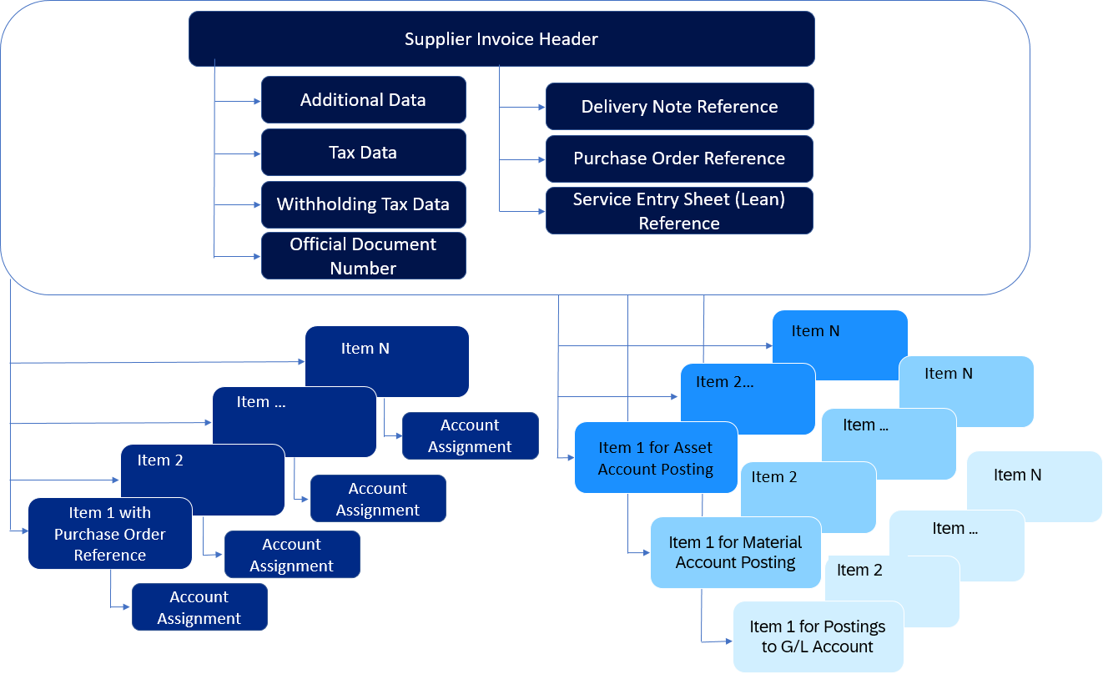
Supplier Invoice Structure with the Main Entites

